Slide 1
Stage-2 Of VAC
-by Team 110

Slide 2
Problem
Traffic issues cause many people to be late on occasions, important or otherwise
Issues such as bottlenecks, infrastructure issues and more cause traffic jams.

Slide 3
Solution
Our solutions looks through the possibility of clearing traffic based on algorithms to generate appropriate times to facilitate smooth flow of traffic
The vehicles are counted and using specific formulae we find the minimum and maximum green times allowed

Slide 4
Stakeholder Analysis
The solution is for everyone affected by traffic issues.
We talked to multiple working people and students who use buses and personal vehicles.
They felt that our solution was apt.

Slide 5
Our idea uses object detection, vehicle densities and counters to accurately calculate the signal timings

Slide 6
We all were stuck in traffic and one of us came up with an idea to improve traffic .
Then we built upon this idea for a couple of weeks picking out and improving the protype.

Slide 7
Problems we faced
We were not able to count vehicles on the first go and had to relearn the process
Our lines had to be redrawn based on coordinates of pixels
Each video had different configurations and different resolutions.
The time estimation was initially inaccurate because of some skewed data

Slide 8
Resource Use
We used documentations of OpenCV and basic python features to build upon the base ideas
Some important handy research papers from IIT Bombay’s CIVIL Department.
Important YouTube tutorials on basic usage of OpenCV

Slide 9
Skill Development
Our team learned how to use OpenCV from basic to advanced levels like accurate object detection
We learnt to import different functions from other files into another file
We learnt to count object based on the coordinates the object passes through
We learnt to map/point out coordinates in the frame

Slide 10
Week 1
Using YouTube tutorials, documentation and studying various projects we learnt how to use OpenCV to detect and draw lines
We also collected other pieces of information to calculate and locate objects
Using functions like contour and blur we drew boxes around the vehicles

Slide 11
Week 2
Studying other projects through out the week we started to move towards ROI detection but due to issues in that area we moved on to linear detection of vehicles
We built small calculating functions to find densities and more
At the end of the week we finally coagulated the files and functions to build a basic working prototype
The final prototype gives values close enough to the actual values with an error of 14%.

Slide 12
Let’s take a look at the codes

Slide 13
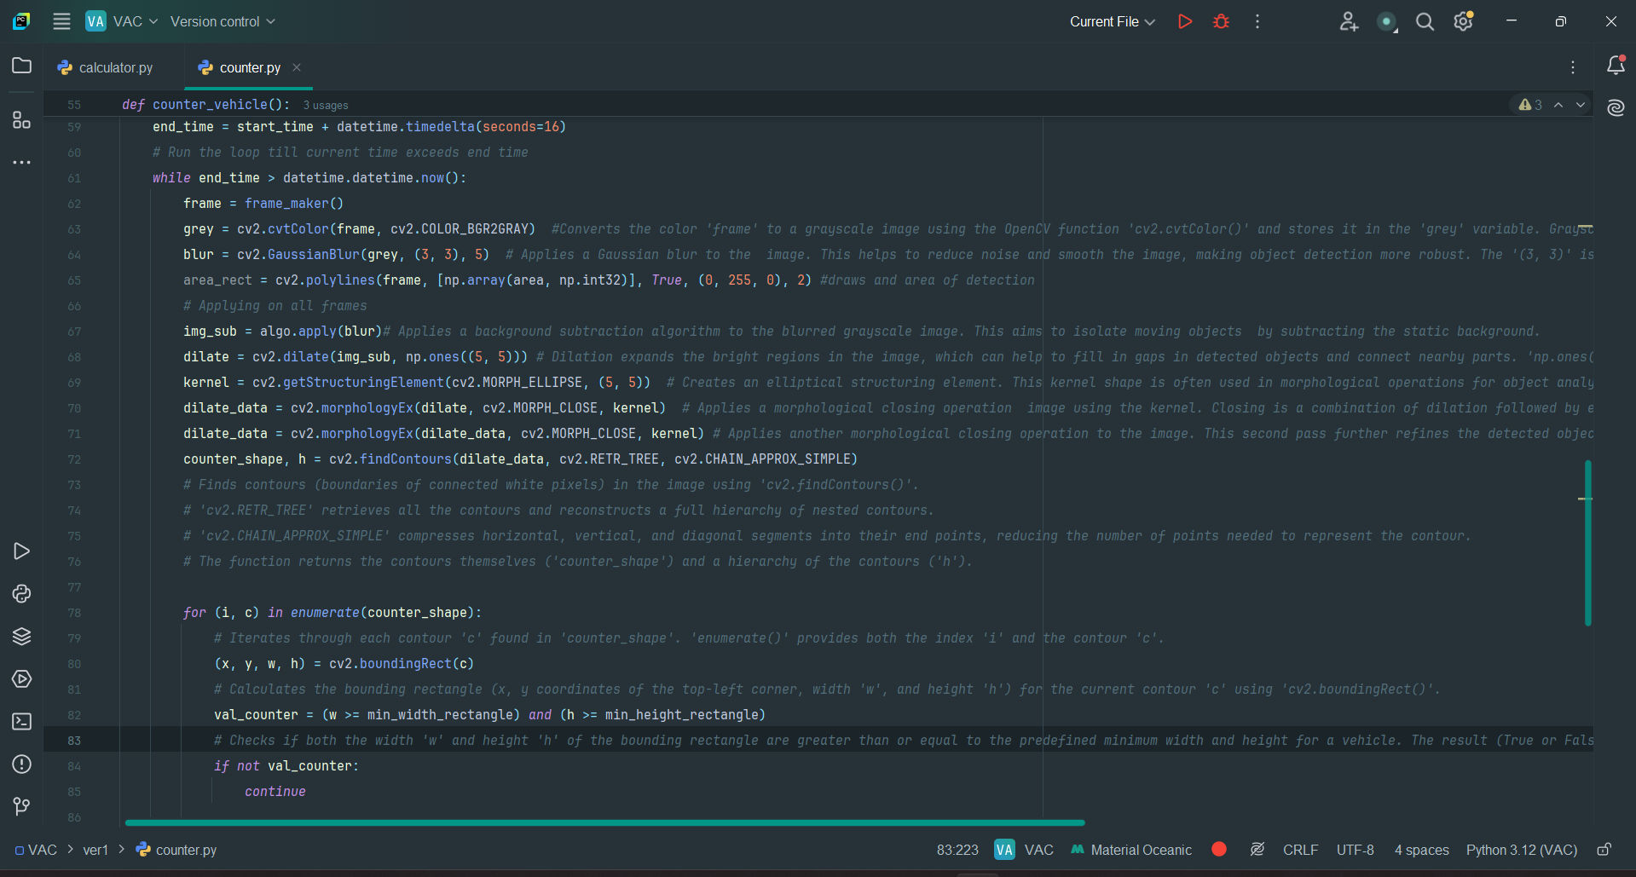
Code for detection and counting

Slide 14
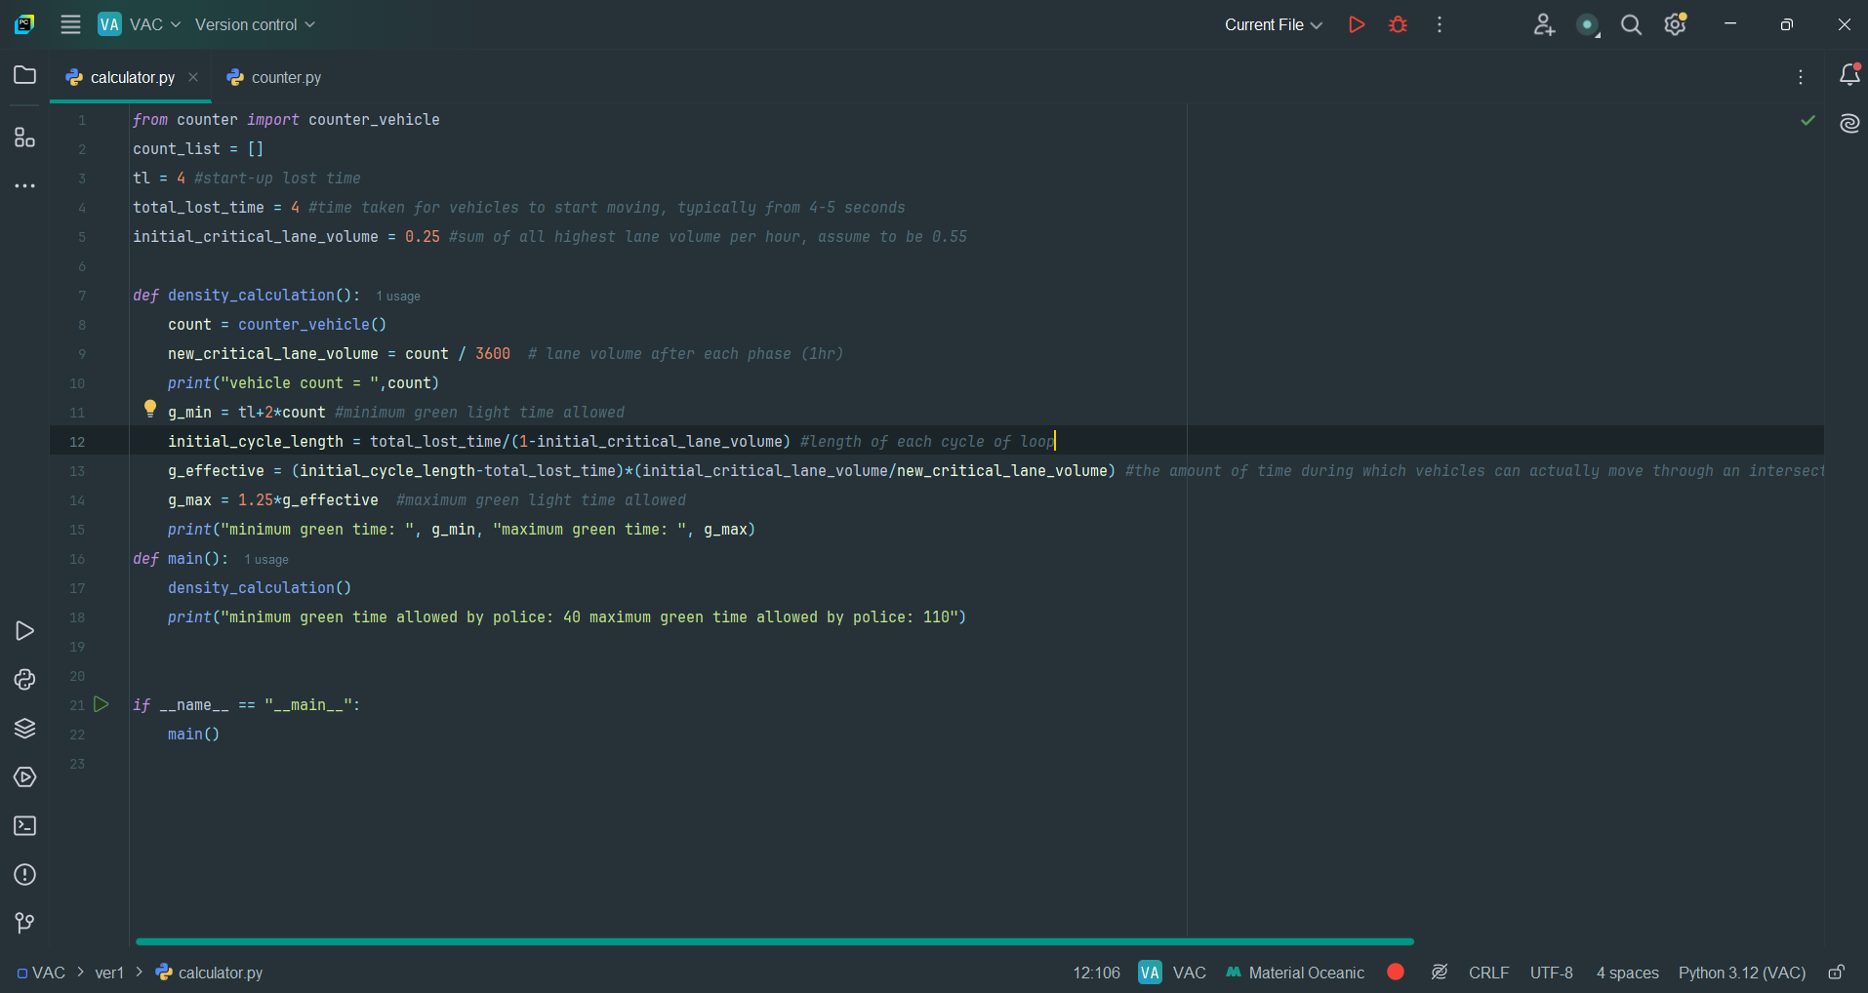
Code to run (basic) calculations

Slide 15
Let’s take a look at the Output

Slide 16
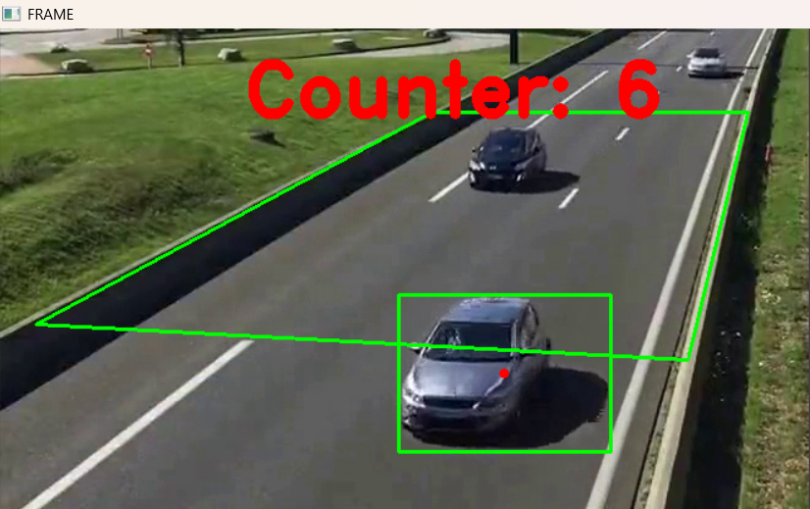
Vehicle counter through OpenCV detection

Slide 17
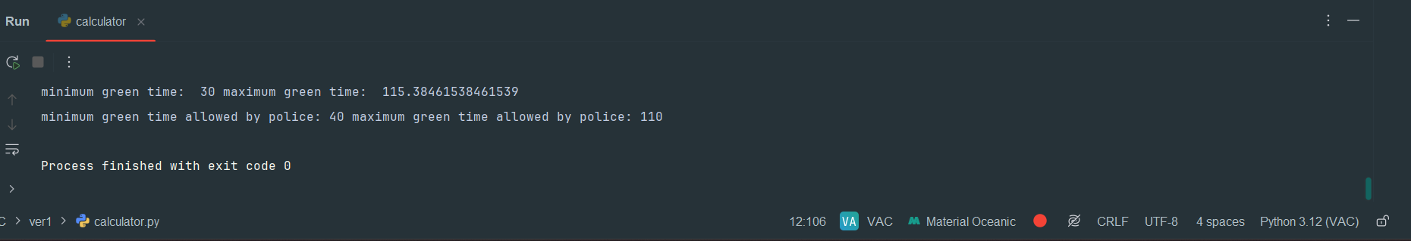
Final output
Actual Times generated by our code

Slide 18
Our contributors
Data Collection like videos and times: Saket Ram, Chetan
Programming the files: Kartik, Shasank
Documentation and presentations: Sudheesh, Chiruhas

Slide 19
THANK YOU, IF ANY QUERY PLEASE ASK!

